Slide 1
FATIGUE
Finite Life/Strength
Cumulative Fatigue Damage

Slide 2
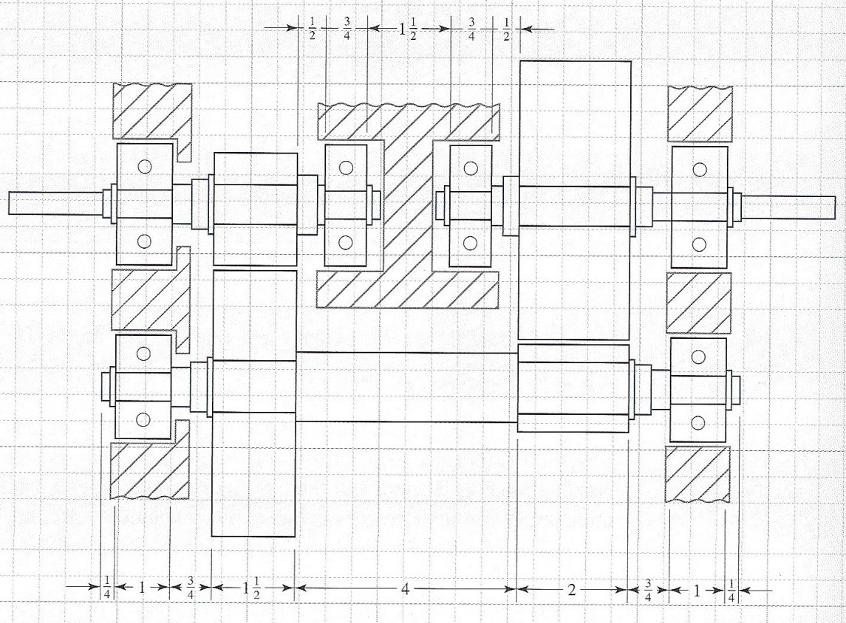
Diagram of Gear Train

Slide 3
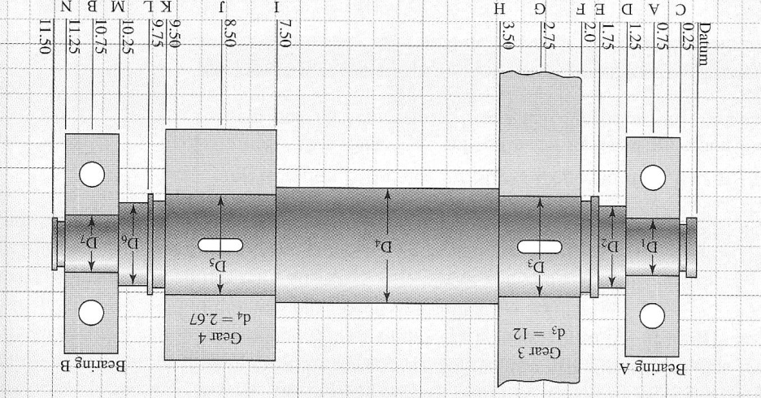
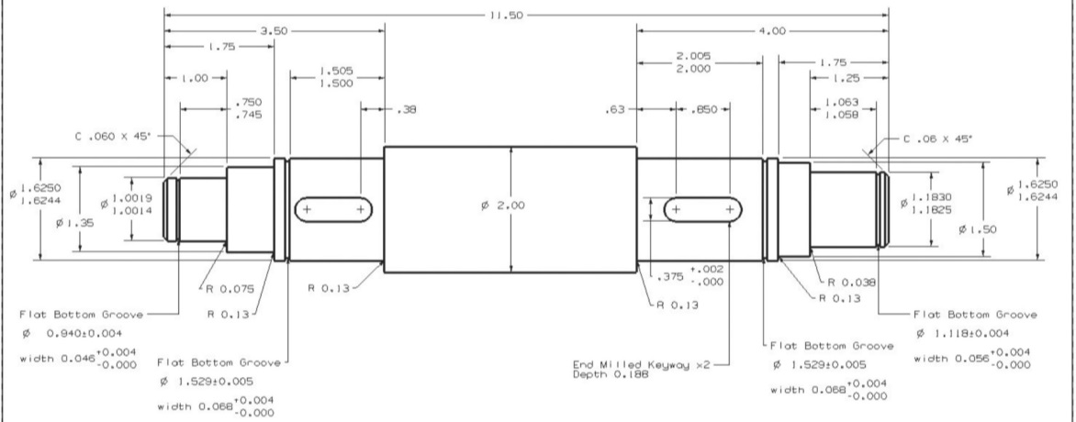
Diagram of actual shaft

Slide 4
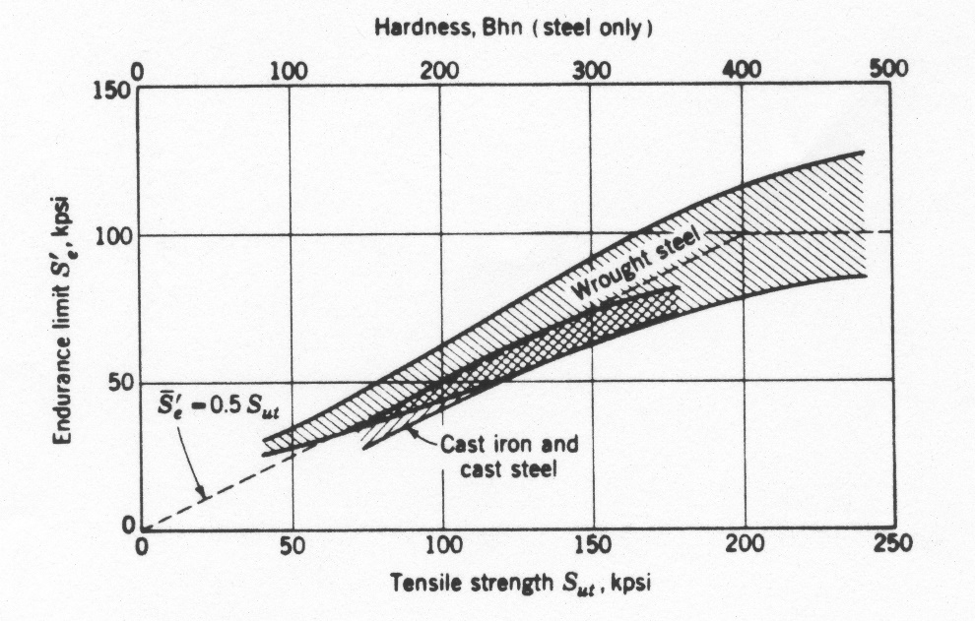
Endurance Limit and Strength

Slide 5
Rules of Thumb
Steel
English Units
Metric Units

Slide 6
Rules of Thumb
Cast Iron
Aluminum and Magnesium

Slide 7
Values (Reported by F.B. Stulen, H.N. Cummings, and W.C. Schulte, Preventing Fatigue Failures, Part 5, Machine Design, vol. 33, P. 161, 22 June 1961)
Material UNS No. (Alloys are heat treated, hot worked, specimens smooth, subjected to long life rotating beam test) | Tensile Strength, S_{ut} |  | Endurance Limit, S’_{E} |  | Standard Deviation
 | MPa | ksi | MPa | ksi | ksi | %
G43400 Steel | 965 1310 1580 1790 | 140 190 230 260 | 489 586 620 668 | 71 85 90 97 | 3.5 6.7 5.3 6.3 | 4.9 7.8 5.9 6.5
G43500 Steel | 2070 | 300 | 689 | 100 | 4.4 | 4.4
R50001-series Titanium Alloy | 1000 | 145 | 579 | 84 | 5.4 | 6.4
A97076 Aluminum Alloy | 524 | 76 | 186 | 27 | 1.6 | 6.0
C63000 Aluminum Bronze | 806 | 117 | 331 | 48 | 4.5 | 9.4
C17200 Beryllium Copper | 1210 | 175 | 248 | 36 | 2.7 | 7.5

Slide 8
Endurance Limit Modifying Factors
S_{e}=k_{a}k_{b}k_{c}k_{d}k_{e}k_{f}S’_{e}
k_{a}-surface factor
k_{b}-size factor
k_{c}-reliability factor
k_{d}-temperature factor
k_{e}-modifying factor for stress concentrations
k_{f}-miscellaneous effects factor

Slide 9
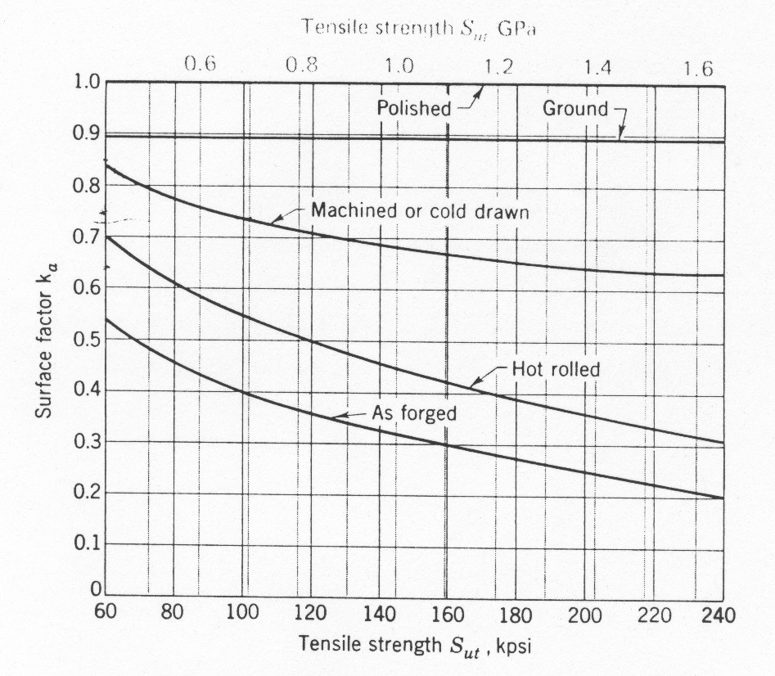
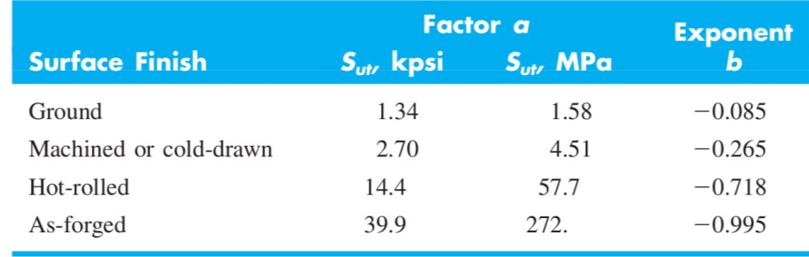
k_{a} – Surface factor

Slide 10
k_{b} – Size Effect
Bending and Rotating of Round Shafts
Axial Loading

Slide 11
k_{b} – Size Effect
Rotating beam test specimen is 0.3 in in diameter
Large specimens
2in dia -> 10 to 25% reduction in S_{e}
Dia > 2in -> 25% reduction
For bending and torsion, k_{b}
d≤0.3in (7.6mm) -> k_{b}=1
0.3≤d≤2.0 -> k_{b}=0.85
d>2.0in -> k_{b}=0.75

Slide 12
k_{c}- Loading Factor
Bending k_{c}=1
Axial k_{c}=0.85
Torsion
k_{c}=0.59 pure torsion
k_{c}=1.0 torsion combined with bending

Slide 13
k_{d} - Temperature
For steel
T < 160 °F -> k_{d}=1
T > 160 °F -> k_{d}=620/(460+T)

Slide 14
Stress Concentration
K_{t} – theoretical or geometric static stress concentration factor
K_{f} – fatigue strength reduction factor
(endurance limit of notch free specimen)/(endurance limit of notched specimens)
K_{f} =1+q(K_{t}-1), q-notch sensitivity
k_{e}=1/K_{f}

Slide 15
Stress Concentration
K_{t} – theoretical or geometric static stress concentration factor
K_{f} – fatigue strength reduction factor
Notch Sensitivity Factor

Slide 16
Neuber Constants,
For Steel and Aluminum Reverse Bending or Reverse Axial
For Steel and Aluminum Reverse Torsion
For Cast Iron it is recommended to use q=0.2

Slide 17
Neuber Constants,
Steel Loaded in Tension
Annealed Aluminum
Hardened Aluminum
S_{ut} (ksi) | 50 | 60 | 70 | 80 | 90 | 100 | 120 | 140 | 160 | 180 | 200 | 220 | 240
S_{ut} (Msi) | 345 | 414 | 483 | 552 | 621 | 689 | 827 | 965 | 1103 | 1241 | 1379 | 1517 | 1655
 | 0.130 | 0.108 | 0.093 | 0.080 | 0.070 | 0.062 | 0.049 | 0.039 | 0.031 | 0.024 | 0.018 | 0.013 | 0.009
S_{ut} (ksi) | 10 | 15 | 20 | 25 | 30 | 35 | 40 | 45
S_{ut} (Msi) | 69 | 103 | 138 | 172 | 207 | 241 | 276 | 310
 | 0.500 | 0.341 | 0.264 | 0.217 | 0.180 | 0.152 | 0.123 | 0.111
S_{ut} (ksi) | 15 | 20 | 30 | 40 | 50 | 60 | 70 | 80 | 90
S_{ut} (Msi) | 103 | 138 | 207 | 276 | 345 | 414 | 483 | 552 | 621
 | 0.175 | 0.380 | 0.278 | 0.219 | 0.186 | 0.162 | 0.144 | 0.131 | 0.122

Slide 18
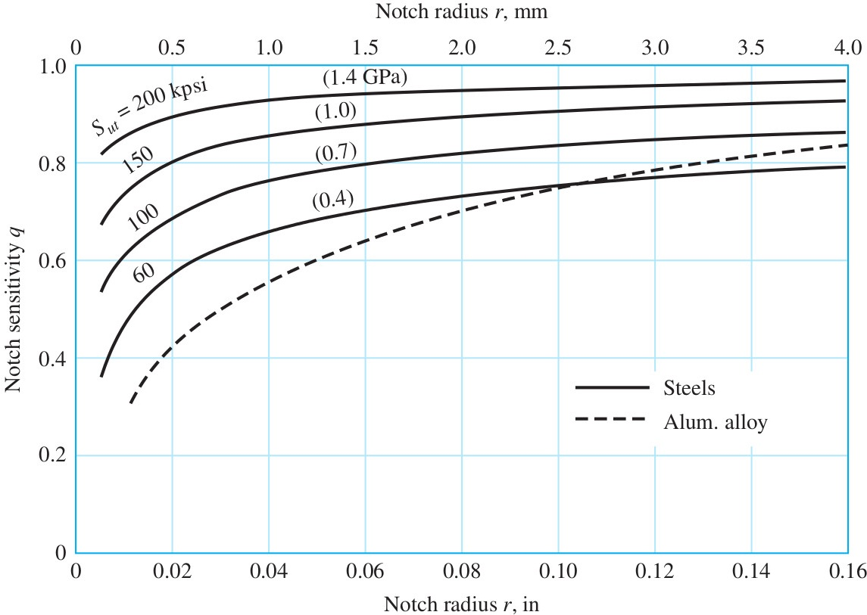
Notch Sensitivity Curves Reverse Bending/Axial

Slide 19
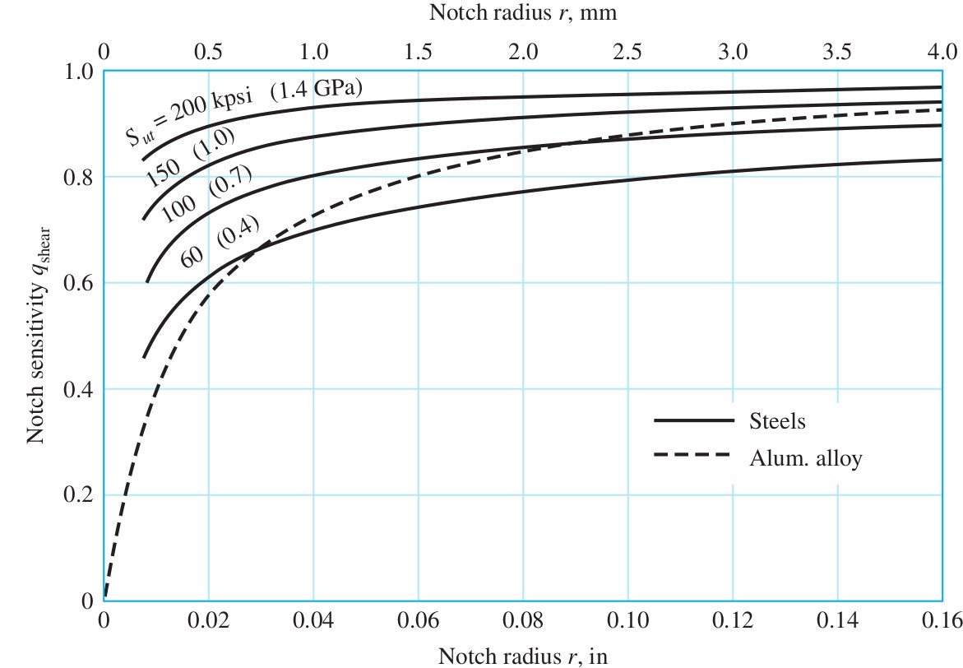
Additional Notch Sensitivity Curves

Slide 20
k_{e} - Reliability
Reliability, R | Standardized Variable, z_{R} | k_{c}
0.50 | 0 | 1.000
0.90 | 1.288 | 0.897
0.95 | 1.645 | 0.868
0.99 | 2.326 | 0.814
0.999 | 3.091 | 0.753
0.999 9 | 3.719 | 0.702
0.999 99 | 4.265 | 0.659
0.999 999 | 4.753 | 0.620
0.999 999 9 | 5.199 | 0.584
0.999 999 99 | 5.612 | 0.551
0.999 999 999 | 5.997 | 0.520

Slide 21
Fatigue Terminology
Stress
σ_{max,} σ_{min}
σ_{m,} σ_{a}
σ_{r}
CYCLE
STRESS
NUMBER OF CYCLES

Slide 22
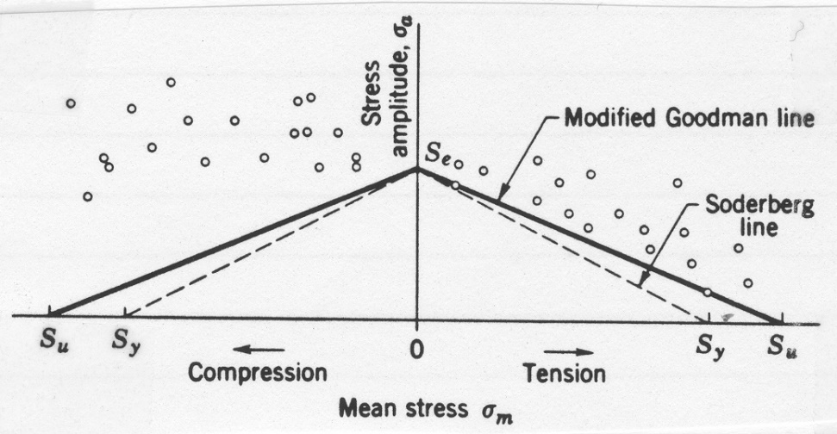
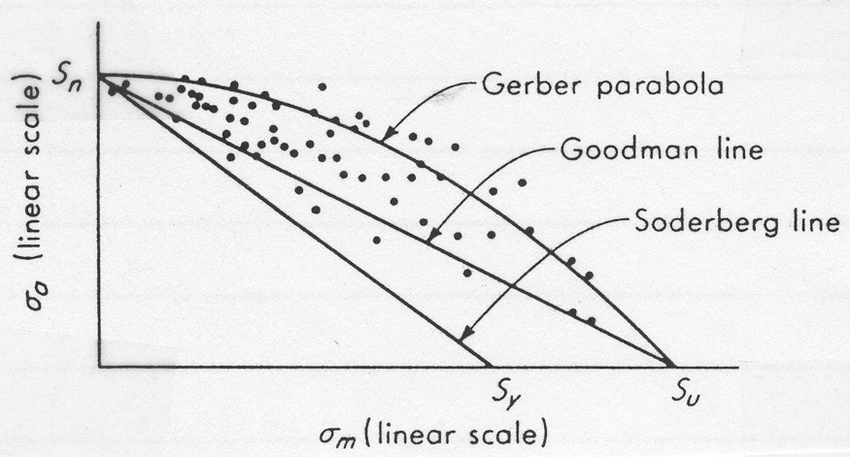
σ_{m}-σ_{a} Diagrams for Axial and Bending Loads

Slide 23
σ_{m}-σ_{a} Diagrams, A Closer Look Modified Goodman Diagram
σ_{a}
S_{y}
S_{e}
σ_{m}
S_{y}
0
S_{y}
S_{u}

Slide 24
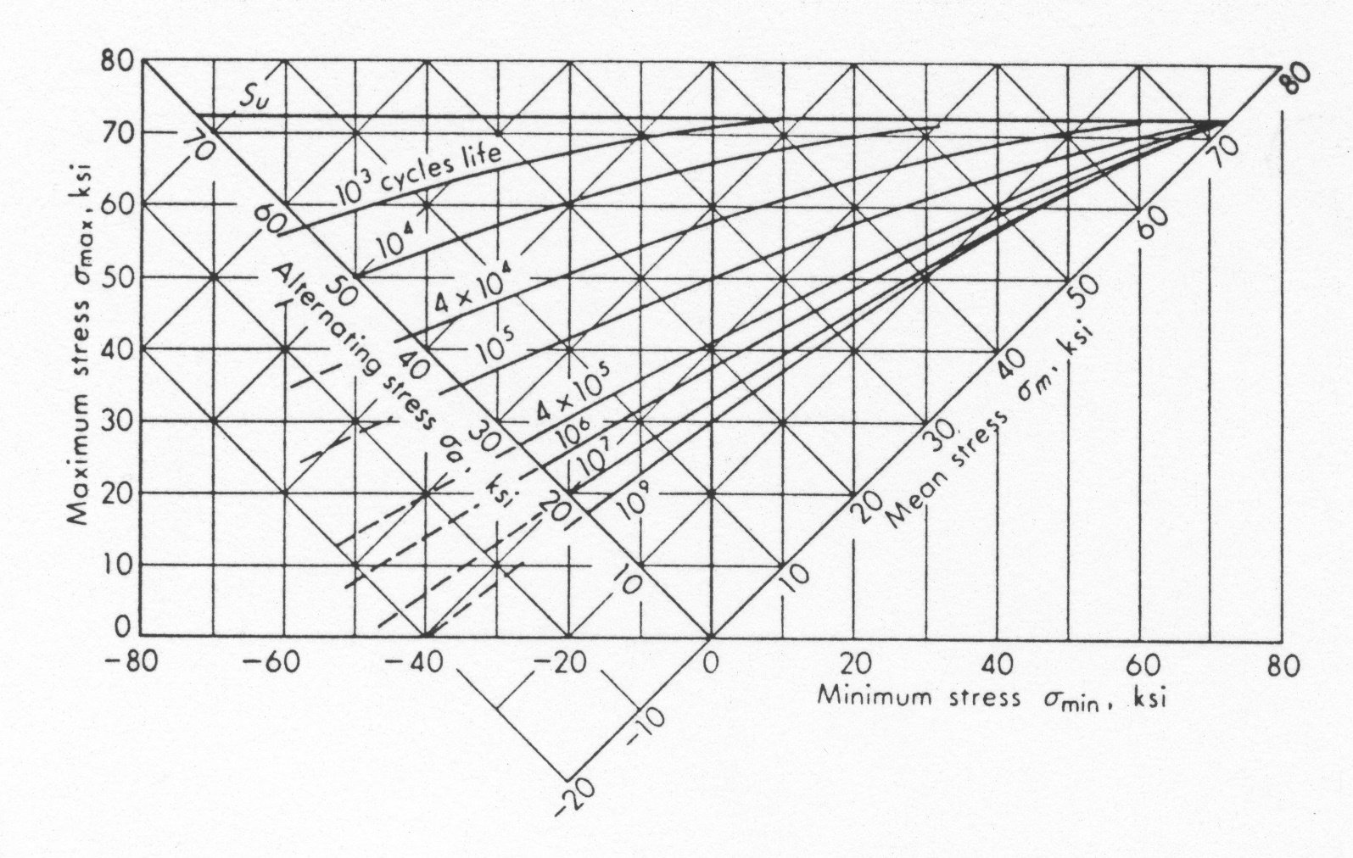
2024 Al

Slide 25
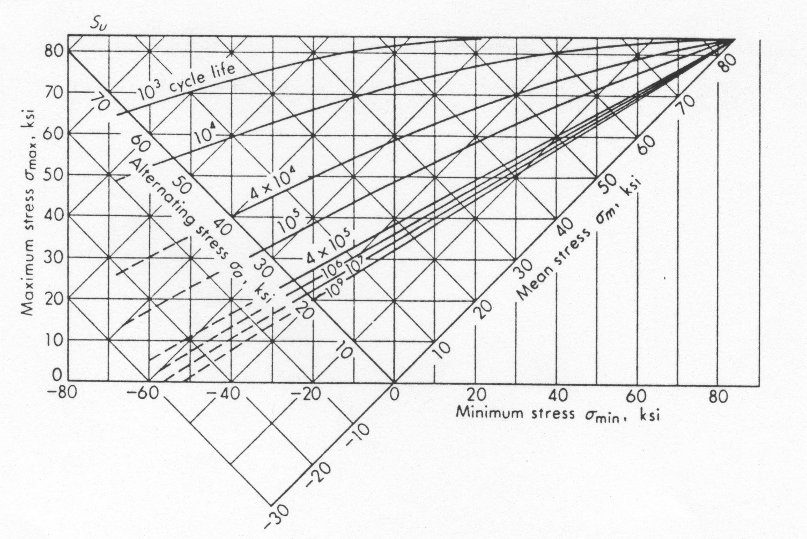
7075 Al

Slide 26
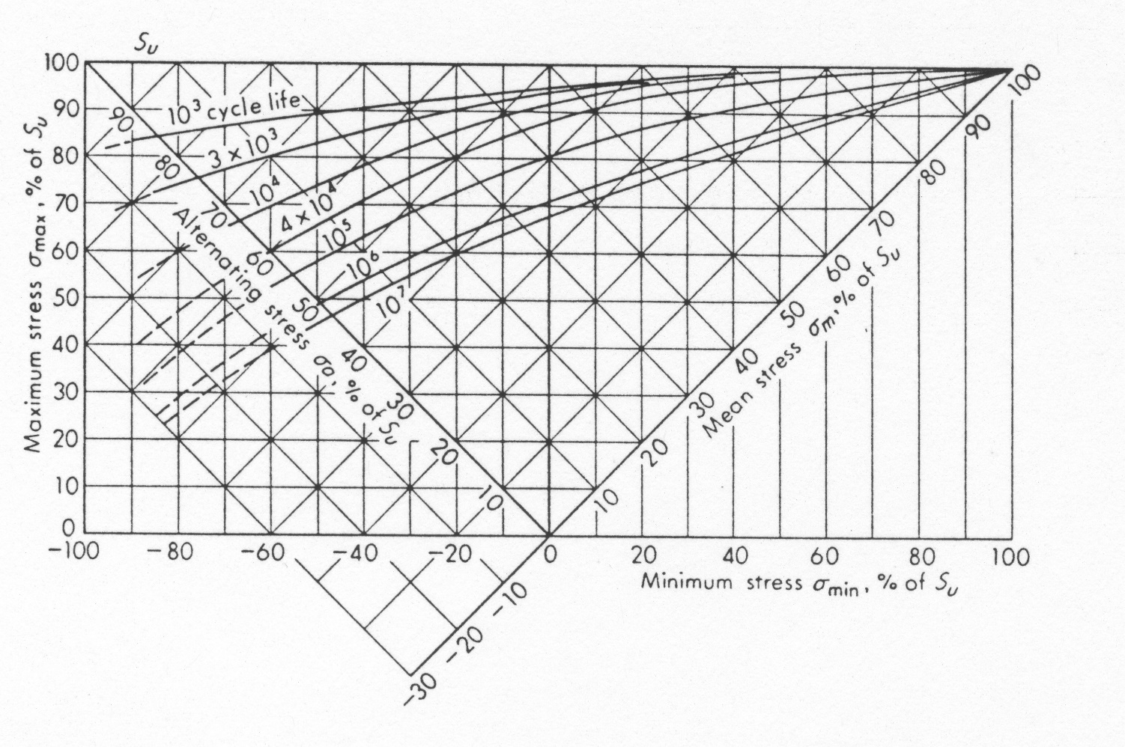
Steel

Slide 27
Fatigue Failure Due to Combined Stresses
Distortional Energy Method
Mean von Mises Stresses
Alternating von Mises Stresses

Slide 28
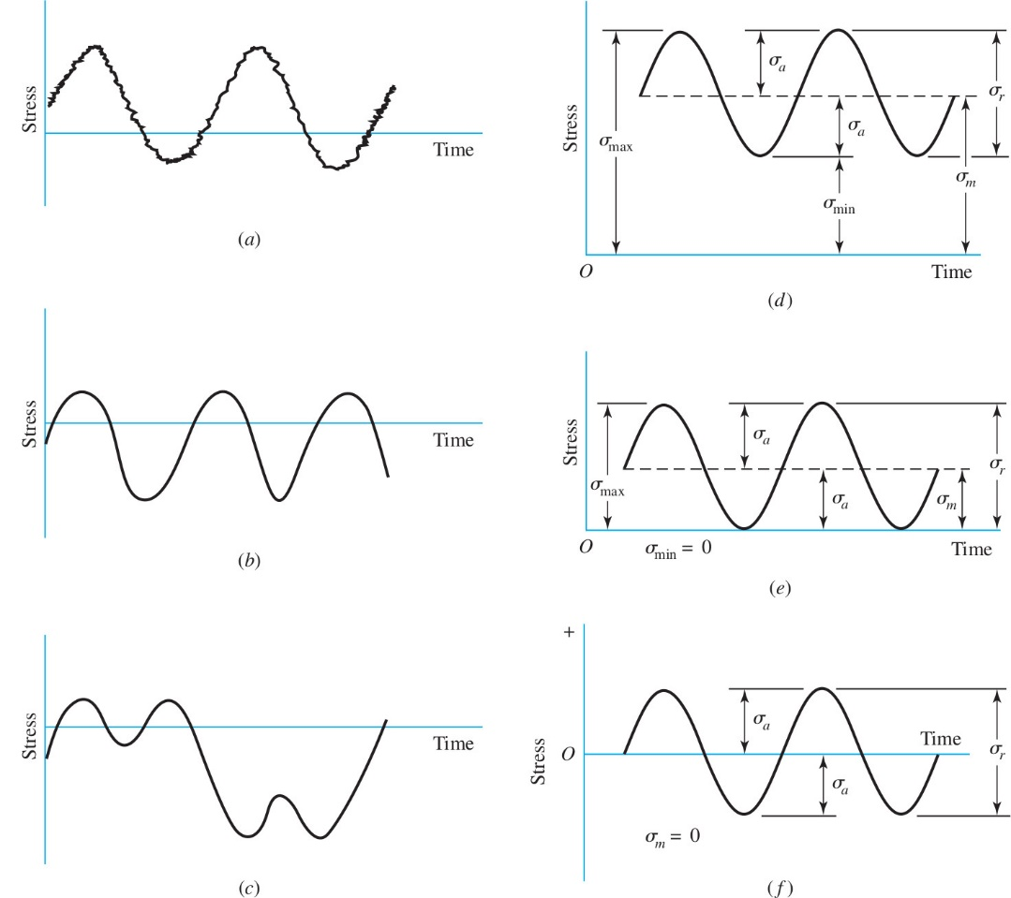
Fluctuating Stress Due to Bending and Torsion

Slide 29
Fluctuating Stress Due to Bending and Torsion

Slide 30
von Mises Equivalent Stresses

Slide 31
Factor of Safety: Three Interpretations
N – Normal Point, Normal Operating Load
Q,P,R – Three interpretations of anticipated design overload points
σ’_{a}
S_{y}
σ_{a}
σ_{m}
S_{e}
Q
P
F
E
N
R
D
σ’_{m}
A
B
C
S_{y}
S_{u}

Slide 32
Using Modified Goodman

Slide 33
Example
A bar of steel has S_{u}=700MPa, S_{y}=500MPa, and a fully corrected endurance limit of S₃=200MPa. For each case below find the factor of safety which guards against static and fatigue failures.
1.
2.
3.
4.

